Slide 1

United Academy Robotics Club

Slide 2
Introduction to our Club
“As a club, we look forward to taking a significant step into the fields of Robotics Engineering and Artificial Intelligence.” Our vision is to explore, learn, and innovate in these rapidly advancing domains. We actively organize workshops, seminars, and hands-on training sessions to enhance technical knowledge and creativity among our members. In addition, we proudly participate in various robotics-related events, exhibitions, and national as well as international competitions, showcasing our skills and fostering teamwork, problem-solving, and innovation. Through these efforts, we aim to inspire young minds to become pioneers in the world of robotics and AI.

Slide 3

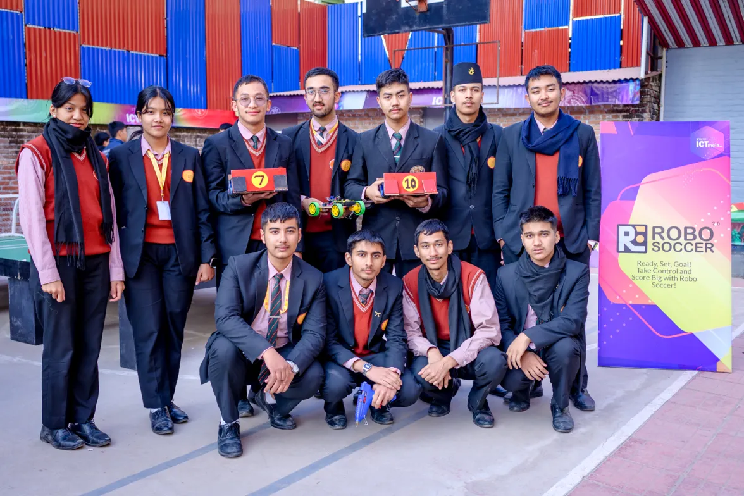
Overview of the club
The United Academy Robotics Club (UARC) is a student-led platform founded in 2015 to promote innovation in robotics and artificial intelligence. It provides hands-on learning through projects, workshops, and competitions like the annual United Robotics Fest, organized with the Robotics Association of Nepal (RAN). The club nurtures creativity, teamwork, and technical skills, preparing students to pursue careers in science, engineering, and technology.

Slide 4
Club Structure and Roles
President
Vice President
Secretary
Treasurer
Program Director
Chief Executive
Vice Secretary
Executive Members

Slide 5

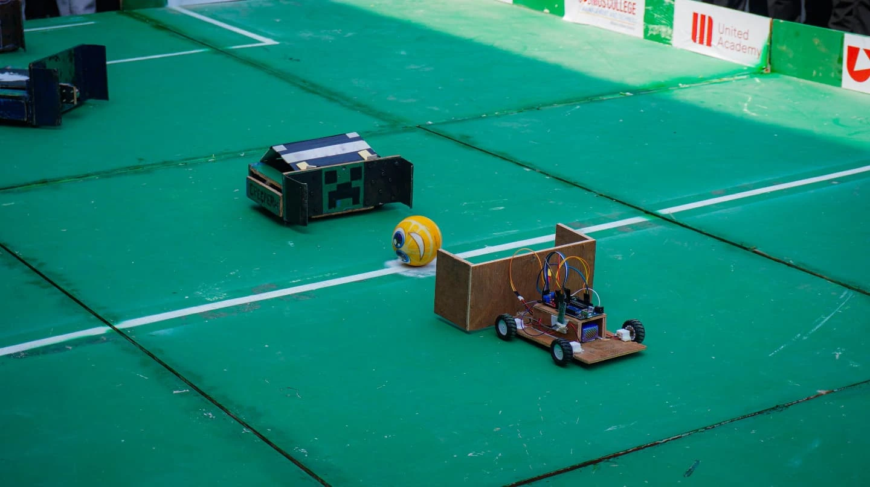
Things we do in the Club
Hands-on Robotics Projects
Workshops and Training Sessions
Annual United Robotics Fest
Competitions and Exhibitions
Collaborations and Mentorship
AI and Automation Projects

Slide 6
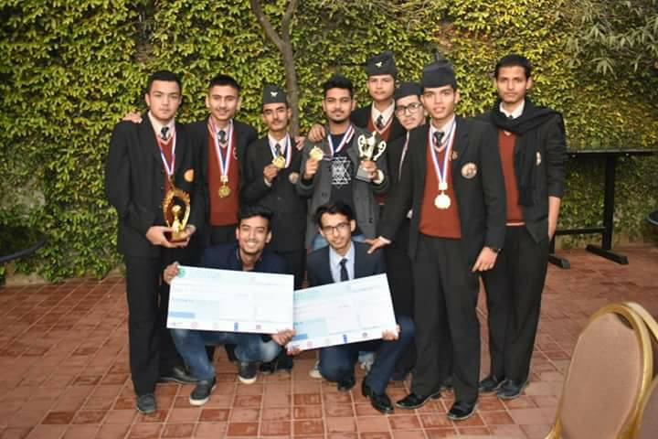
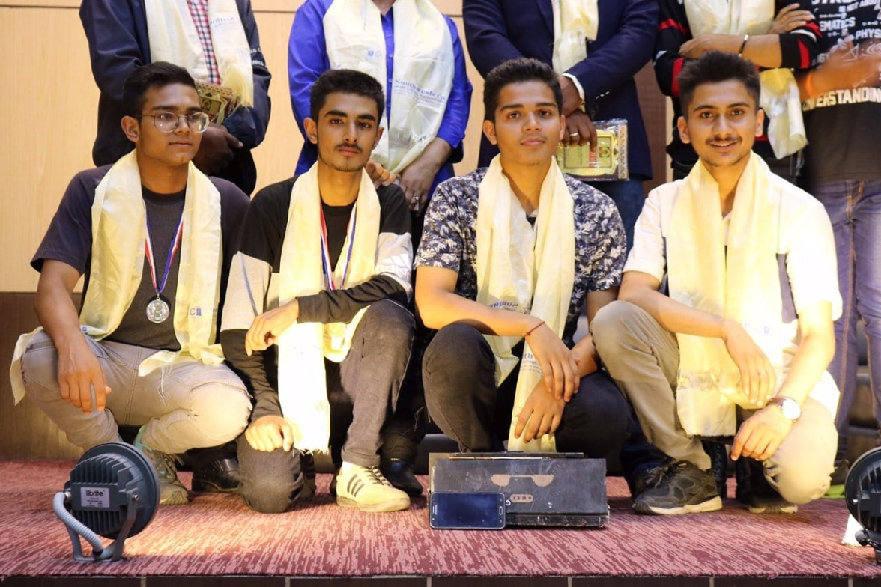
Past of Robotics Club
Secured 2nd place in the “AI for Good” competition
Achieved 3rd position in technoXian
Participation in ICT mela
Organized RoboFest 3.0
Organization of various workshops in collaboration with Virinchi college

Slide 7
Any questions?

